Slide 1
ADVANCED DATA MODELING
Database Concepts Spring 2021
Week 9

Slide 2
Extended Entity Relationship Model (EERM)
Result of adding more semantic constructs to the original entity relationship (ER) model
EER diagram (EERD): Uses the EERM
Notes:
The extended entity relationship model (EERM), also called the enhanced entity relationship model, is the result of adding more semantic constructs to the original entity relationship (ER) model.
A diagram that uses the EERM is called an EER diagram (EERD).
The main EER model constructs include entity supertypes, entity subtypes, and entity clustering.

Slide 3
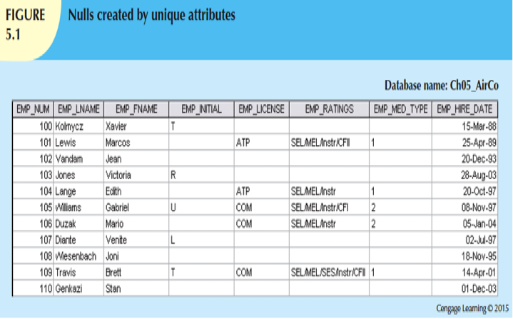
Notes:
In this case, special pilot characteristics such as EMP_LICENSE, EMP_RATINGS, and EMP_MED_TYPE will generate nulls for employees who are not pilots
An aviation business that employs pilots, mechanics, secretaries, accountants, and many other types of employees.
if all employee characteristics and special qualifications were stored in a single EMPLOYEE entity, you would have a lot of nulls.
In addition, pilots participate in some relationships that are unique to their qualifications.

Slide 4
Entity Supertypes and Subtypes
Entity supertype
Generic entity type related to one or more entity subtypes
Contains common characteristics
Minimize the number of nulls
Minimize the likelihood of redundant relationships
Entity subtype
Contains unique characteristics of each entity subtype
Criteria to determine the usage
There must be different, identifiable kinds of the entity in the user’s environment
The different kinds of instances should each have one or more attributes that are unique to that kind of instance

Slide 5
Inheritance
Enables an entity subtype to inherit attributes and relationships of the supertype
All entity subtypes inherit their primary key attribute from their supertype
At the implementation level, supertype and its subtype(s) maintain a 1:1 relationship
Entity subtypes inherit all relationships in which supertype entity participates (called IS-A relationships)
Lower-level subtypes inherit all attributes and relationships from its upper-level supertypes
Notes:
A PILOT subtype occurrence is related to one instance of the EMPLOYEE supertype.
All of the attributes for the supertype table are placed into the subtype table: (T/F)

Slide 6
Subtype Discriminator
Attribute(s) in the supertype entity that determines to which entity subtype the supertype occurrence is related
Notes:
subtype discriminator use to define the constraints

Slide 7
Specialization Hierarchy
Provides the means to:
Support attribute inheritance
Define a special supertype attribute known as the subtype discriminator
Define disjoint/overlapping constraints and complete/partial constraints

Slide 8
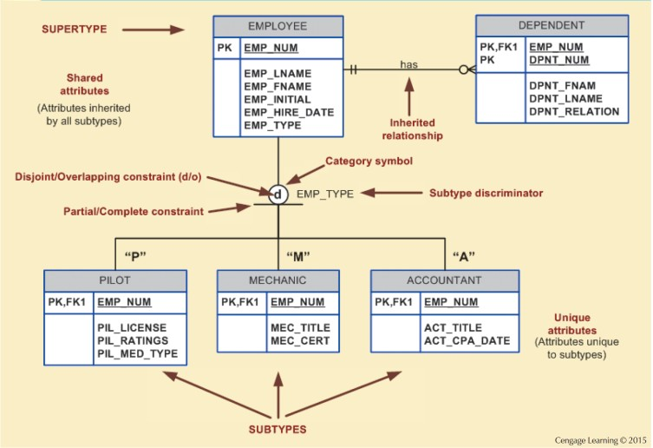
Figure 5.2 - Specialization Hierarchy
Notes:
.

Slide 9
Disjoint and Overlapping Constraints
Disjoint subtypes: Each entity instance of the supertype appear in only one of the subtypes
Known as nonoverlapping subtypes (d)
Implementation is based on the value of the subtype discriminator attribute in the supertype (EMP_TYPE)
Overlapping subtypes: Each entity instance of the supertype may appear in more than one subtype
Implementation requires the use of one discriminator attribute for each subtype (EMP_IS_P, EMP_IS_M, EMP_IS_A…) (O)

Slide 10
Completeness Constraint
Specifies whether each supertype occurrence must also be a member of at least one subtype
Types
Partial completeness: Not every supertype occurrence is a member of a subtype
Total completeness: Every supertype occurrence must be a member of at least one subtype

Slide 11
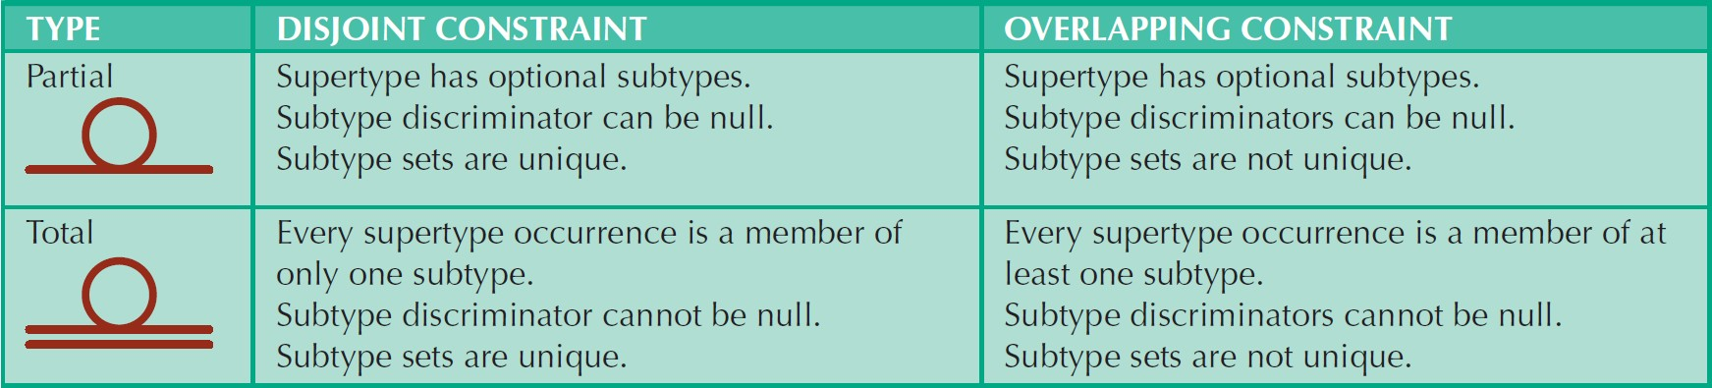
Table 5.2 - Specialization Hierarchy Constraint Scenarios

Slide 12
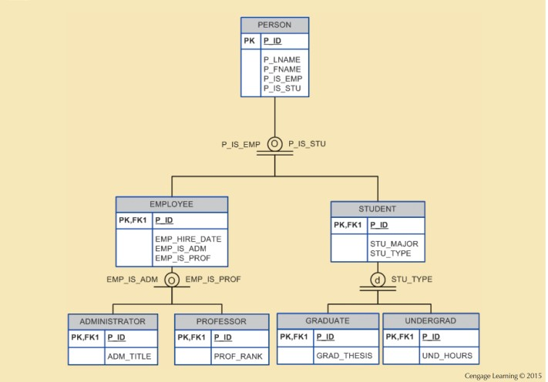
Figure 5.4 - Specialization Hierarchy with Overlapping Subtypes

Slide 13
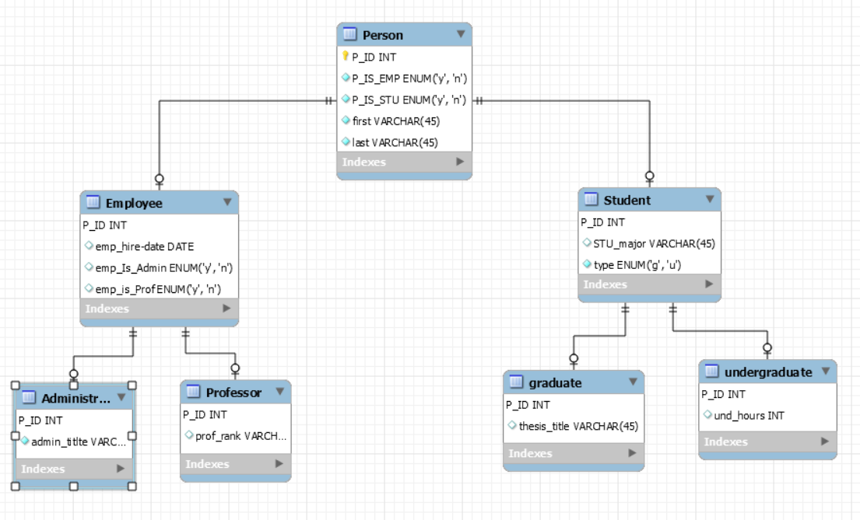
Notes:
Relationships connecting supertypes and subtypes are called IS-A relationships, because a subtype is a supertype.
The identifier of the supertype and all of its subtypes must be identical; i.e., the identifier of the supertype becomes the identifier of the related subtype(s).

Slide 14
Entity Cluster
Temporary (virtual) entity used to represent multiple entities and relationships in ERD
Combining multiple interrelated entities into a single abstract entity object
Represent multiple entities and relationships to simplify the ERD and enhance its readability

Slide 15
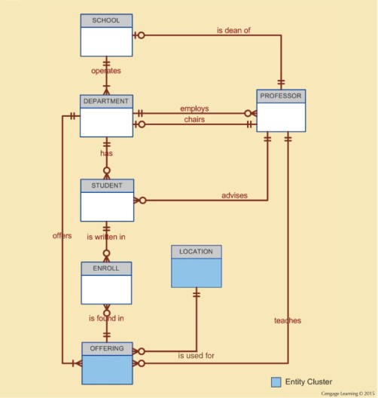
Figure 5.5 - Tiny College ERD Using Entity Clusters
Notes:
This Tiny College ERD contains two entity clusters:
• OFFERING, which groups the COURSE and CLASS entities and relationships
• LOCATION, which groups the ROOM and BUILDING entities and relationships
When using entity clusters, the key attributes of the combined entities are no longer available. The general rule is to avoid the display of attributes when entity clusters are used.

Slide 16
Primary Keys
Single attribute or a combination of attributes, which uniquely identifies each entity instance
Guarantees entity integrity
Works with foreign keys to implement relationships

Slide 17




Desirable Primary Key Characteristics (Table 5.3)
Nonintelligent
No change over time Preferably single-attribute Preferably numeric Security-compliant
Notes:
Non-intelligent: The PK should not have embedded semantic meaning.
No change over time:
Preferably single-attribute: A primary key should have the minimum number of attributes possible. Single-attribute primary keys are desirable but not required.
Preferably numeric: Unique values can be better managed when they are numeric.
Security complaint: primary key must not be composed of any attribute(s) that might be considered a security risk or violation.

Slide 18
Use of Composite Primary Keys
Composite primary keys are useful in two cases:
As identifiers of composite entities, in which each primary key combination is allowed only once in the M:N relationship.
As identifiers of weak entities, in which the weak entity has a strong (identifying) relationship with the parent entity.
Notes:
the primary key should use the minimum number of attributes possible. However, that does not mean that composite primary keys are not permitted in a model.

Slide 19
Surrogate Keys
A primary key created by the database designer to simplify the identification of entity instances
There is no natural key
Selected candidate key has embedded semantic contents or is too long
Notes:
In some instances a primary key doesn’t exist in the real world. In these cases, it is standard practice to create a surrogate key.
The surrogate key has no meaning in the user’s environment—it exists only to distinguish one entity instance from another (just like any other primary key).
One practical advantage of a surrogate key is that because it has no intrinsic meaning, values for it can be generated by the DBMS to ensure that unique values are always provided.

Slide 20
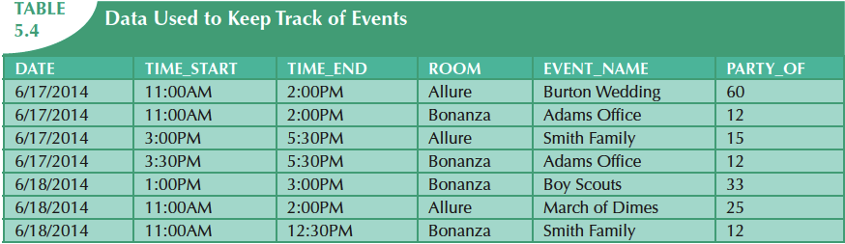
Table 5.4 – Data Used to Keep Track of Events
EVENT (DATE, TIME_START, TIME_END, ROOM, EVENT_NAME, PARTY_OF)

Slide 21
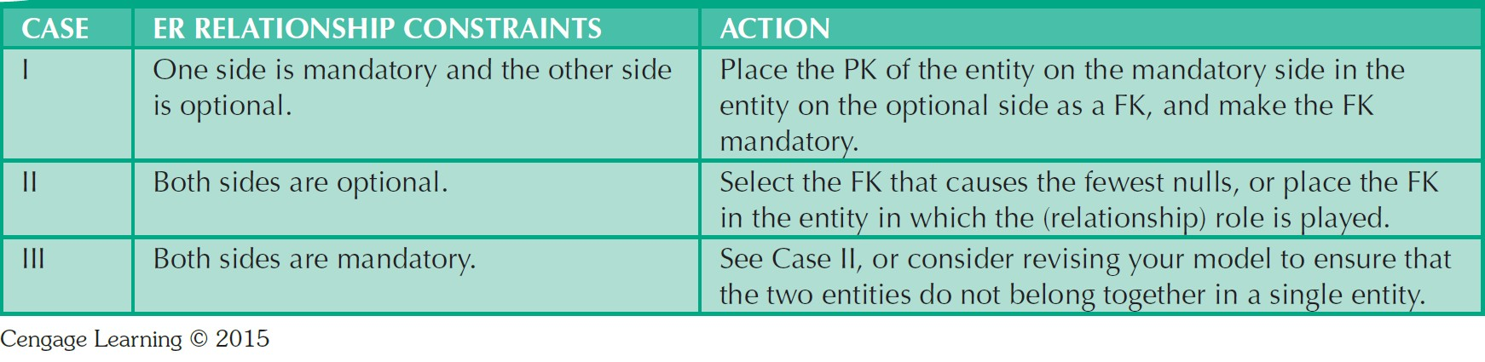
Design Case 1: Implementing 1:1 Relationships
Foreign keys work with primary keys to properly implement relationships in relational model
Rule
Select the design which cause the fewest nulls
Notes:
http://db.grussell.org/section006.html#_Toc67114426

Slide 22
Mandatory at both ends
Each staff must have one contract, each contract must have one staff associated with it.
Subsume one entity type into the other:
Staff (emp_no, name, cont_no, start, end, position, salary)
Kept apart and a foreign key used
Staff (emp_no, name, cont_no)
Contract (cont_no, start, end, position, salary)
Or:
Staff (emp_no, name)
Contract (cont_no, start, end, position, salary, emp_no)
Notes:
If the relationship is mandatory at both ends it is often possible to subsume one entity into the other.
The choice of which entity subsumes the other depends on which one is the most important one (more attributes, better primary key, semantic nature of them).
The result of this amalgamation is that all the attributes of the `swallowed up' entity become attributes of the more important entity.
The key of the subsumed entity type becomes a normal attribute.
If there are any attributes in common, the duplicates are removed.
The primary key of the new combined entity is usually the same as that of the original more important entity.
When not to combine
There are a few reason why you might not combine a 1:1 mandatory relationship.
the two entity types represent different entities in the `real world'.
the entities participate in very different relationships with other entities.
If not combined...
If the two entity are kept separate then the association between them must be represented by a foreign key.
The primary key of one entity type becomes the foreign key in the other.
It does not matter which way around it is done but you should not have a foreign key in each entity.

Slide 23
Optional at both ends
Each staff may lease one car, each car may be leased by one staff.
Subsume one entity type into the other?
Staff_car (emp_no, name, reg_no, year, make, type, colour)
Entities cannot be amalgamated as you could not select a primary key. Instead, one foreign key (causes the fewest null) must be used.
Notes:
If emp_no is used then all the cars which are not being leased will not have a key.
Similarly, if the reg_no is used, all the staff not leasing a car will not have a key.
A compound key will not work either.

Slide 24
Design Case 2: Maintaining History of Time-Variant Data
Time-variant data: Data whose values change over time and for which a history of the data changes must be retained
Requires creating a new entity in a 1:M relationship with the original entity
New entity contains the new value, date of the change, and other pertinent attribute
Notes:
Some time-variant data is equivalent to having a multivalued attribute in your entity.
To model this type of time-variant data, you must create a new entity in a 1:M relationship with the original entity.
This new entity will contain the new value, the date of the change, and any other attribute that is pertinent to the event being modeled.

Slide 25
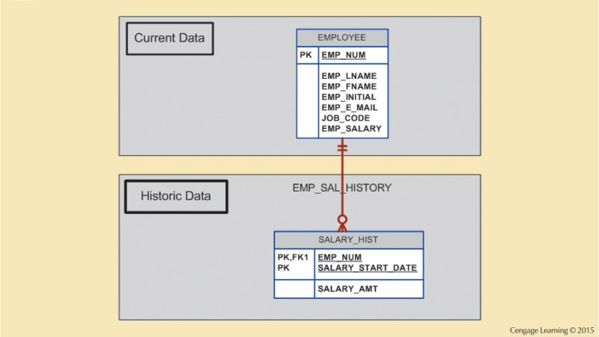
Figure 5.8 - Maintaining Salary History
Notes:
If you want to track salary histories for each employee, then the EMP_SALARY attribute becomes multivalued.
For each employee, there will be one or more records in the SALARY_HIST entity.

Slide 26
Things to do:
Quiz 3 is due today.
Quiz 4 is due Mar. 10th (Ch5)
Today’s code: Supertype and Subtype Relationships.

